Slide 1
CE80362: Circuit Analysis
Lecture 4:
Sinusoidal steady state analysis.

Slide 2
Introduction to Alternating currents (ac)
-Alternating currents (ac) are currents that alternate in direction (usually many times per second), passing ﬁrst in one direction, then in the other through a circuit.
-Such currents are produced by voltage sources whose polarities alternate between positive and negative (rather than being ﬁxed as with dc sources).
-By convention, alternating currents are called ac currents and alternating voltages are called ac voltages.
-The variation of an ac voltage or current versus time is called its waveform.
-Since waveforms vary with time, they are designated by lowercase letters v(t), i(t ), e(t ), and so on, rather than by uppercase letters V, I , and E as for dc. Often we drop the functional notation [e.g., v(t )] and just use the simpler notations v, i, and e instead.

Slide 3
Sinusoidal ac Voltage
To illustrate, consider the voltage at the wall outlet in your home. Called a sine wave or sinusoidal ac waveform
Starting at zero, the voltage increases to a positive peak amplitude, decreases to zero, changes polarity, increases to a negative peak amplitude, then returns again to zero.
One complete variation is referred to as a cycle.
Since the waveform repeats itself at regular intervals as in (b), it is called a periodic waveform.

Slide 4
Sinusoidal ac Current
During the ﬁrst half cycle, the source voltage is positive; therefore, the current is in the clockwise direction.
During the second half-cycle, the voltage polarity reverses; therefore, the current is in the counterclockwise direction.
Since current is proportional to voltage, its shape is also sinusoidal.

Slide 5
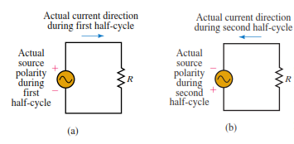

Figure to illustrate sinusoidal current and voltage
The figure below shows a resistor connected to an ac source.
Periodic waveforms (i.e., waveforms that repeat at regular intervals), regardless of their wave shape, may be described by a group of attributes such as frequency, period, amplitude, peak value.

Slide 6
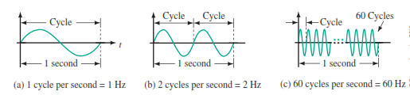
Frequency
The number of cycles per second of a waveform is deﬁned as its frequency. By definition,
In Figure (a), one cycle occurs in one second; thus its frequency is one cycle per second.
Similarly, the frequency of (b) is two cycles per second and that of (c) is 60 cycles per second.
Frequency is denoted by the lowercase letter f.
Its unit is the hertz.

Slide 7
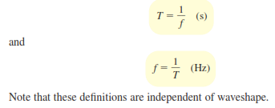
Period
The period, T, of a waveform is the duration of one cycle. It is the inverse of frequency.
To illustrate, consider again Figure on previous slide.
In (a), the frequency is 1 cycle per second; thus, the duration of each cycle is T = 1 s. In (b), the frequency is two cycles per second; thus, the duration of each cycle is T =1/2 s, and so on.
In general,

Slide 8
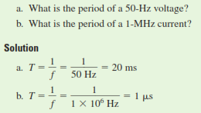
Example
Frequency and period, T
The period of a waveform can be measured between any two corresponding points. Often it is measured between zero points or peak points because they are easy to establish on an oscilloscope trace.
The amplitude of a sine wave is the distance from its average to its peak. Thus, the amplitude of the voltage is Em and current is im

Slide 9
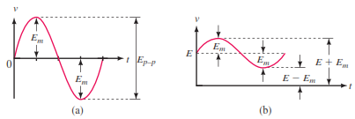
Peak voltage and current
Peak-to-peak voltage is also indicated in figure. It is measured between peak and trough values. Peak-to-peak voltages are denoted Ep-p or Vp-p. (Some may use V or i)
Similarly, peak to-peak currents are denoted as Ip-p, pk-pk.
To illustrate, consider again Figure below. The amplitude of this voltage is E=40 V, and its peak-to-peak voltage is Ep-p 80 V. then Ep-p= 2*Em
The peak value of a voltage or current is its maximum value with respect to zero. Consider Figure (b). Here, a sine wave rides on top of a dc value, yielding a peak that is the sum of the dc voltage and the ac waveform amplitude. For the case indicated, the peak voltage is E _ Em

Slide 10
Instantaneous Value
In ac, the coil voltage changes from instant to instant. The value of voltage at any point on the waveform is referred to as its instantaneous value.

Slide 11

The Basic Sine Wave Equation
The sine wave equation is given by
Where E_{m} is the maximum coil voltage and α is the instantaneous angular position of the coil.
For α= 0⁰ represents the horizontal position of the coil and that one complete cycle corresponds to 360⁰.
Equation above states that the voltage at any point on the sine wave may be found by multiplying E times the sine of the angle at that point.

Slide 12

example

Slide 13
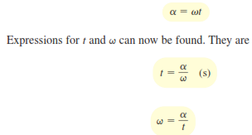
Angular Velocity, ω
The rate at which the generator coil rotates is called its angular velocity.
If the coil rotates through an angle of 30⁰ in 1 second, for example, its angular velocity is 30⁰ per second.
Angular velocity is denoted by the Greek letter ω (omega). For the case cited, ω= 30º per sec.
Angular velocity is expressed in radians per second instead of degrees per second.
When you know the angular velocity of a coil and the length of time that it has rotated, you can compute the angle through which it has turned.
For example, a coil rotating at 30º per sec rotates through an angle of 30º in 1 second, 60º in 2 seconds, 90º in 3 seconds, and so on. In general,

Slide 14
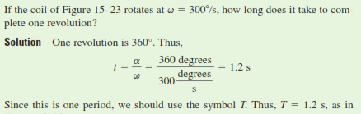
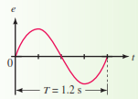
example
And its respective graph is shown below

Slide 15
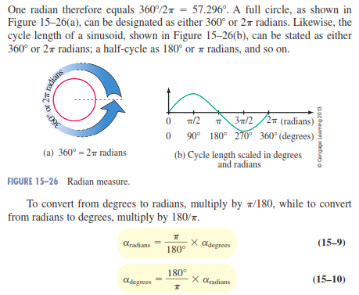
Radian Measure
In practice, ∏ is usually expressed in radians per second, where radians and degrees are related by the identity.

Slide 16
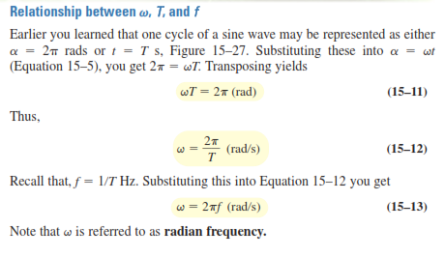
Relationship between

Slide 17
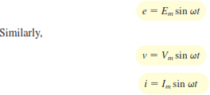
Sinusoidal Voltages and Currents as Functions of Time
Recall from Equation and from Equation α=ωt Combining these equations yields
These equations may be used to compute voltages or currents at any instant in time.

Slide 18

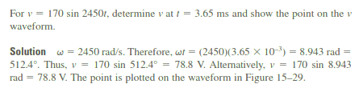
Examples

Slide 19
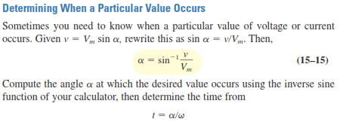
Determining when a particular value occurs

Slide 20
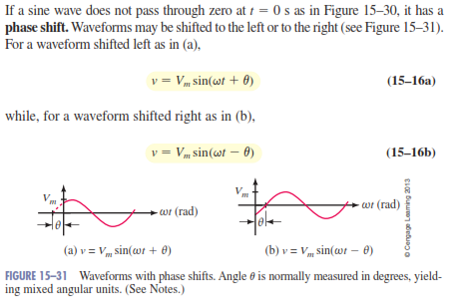
Voltages and Currents with Phase Shifts

Slide 21
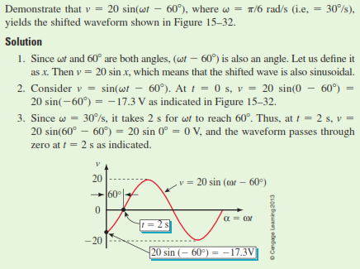
Examples

Slide 22



Average and root mean square (RMS) values
By using an analytical or mathematical way of finding the RMS value, aperiodic sinusoidal voltage is constant and can be defined as V_{(t)} = Vm.cos(ωt) with a period of T. Then we can calculate the root-mean-square (rms) value of a sinusoidal voltage (V_{(t)}) as:
Integrating through with limits taken from 0 to 360º or “T”, the period gives:
Dividing through further as ω = 2π/T, the complex equation above eventually reduces down to:

Slide 23
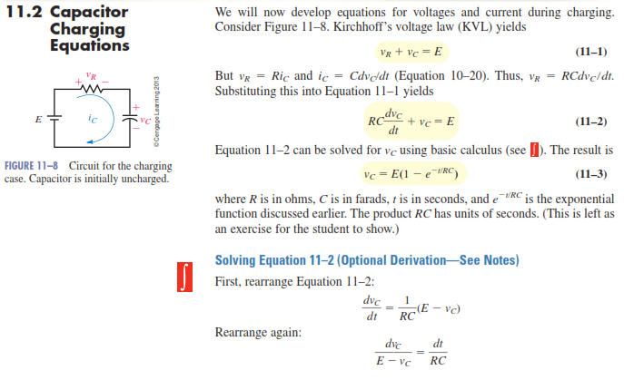
Capacitor charging equations

Slide 24
Natural and Forced response (RC, RL & RLC)
Natural response (source free response) is the system's response to initial conditions with all external forces set to zero.
In circuits, this would be the response of the circuit with initial conditions (initial currents on inductors and initial voltage on capacitors for example) with all the independent voltages set to zero volts (short circuit) and current sources set to zero amps (open circuit).
The natural response of the circuit will be dictated by the time constants.
That is, Natural response: refers to the behavior (in terms of voltages and currents) of the circuit, with no external sources of excitation.

Slide 25
Forced response is the system's response to an external stimulus with zero initial conditions. In circuits, this would just be the response of the circuit to external voltage and current source forcing function.
In electrical circuit, The forced response appears when the sources (Voltage or current source) is acting on the circuit. In this case, the response depends on those sources.
Complete response = natural response + forced response.
The time-varying currents and voltages resulting from the sudden application of sources, usually due to switching, are called transients. By writing circuit equations, we obtain integro-differential equations

Slide 26
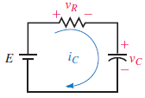
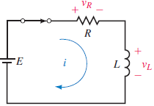
First-Order Circuits (refer to slide 23)
A circuit that contains only sources, resistors and an inductor is called an RL circuit.
A circuit that contains only sources, resistors and a capacitor is called an RC circuit.
RL and RC circuits are called first-order circuits because their voltages and currents are described by first-order differential equations.
RLC is a second order circuits
Circuit for the charging case. Capacitor is initially uncharged.

Slide 27
Review on Reactance X, and Impedance of R, L, and C
Resistance R is essentially friction against the motion of electrons. It is present in all conductors to some extent, most notably in resistors.
When alternating current goes through a resistance, a voltage drop is produced that is in-phase with the current.
Reactance X is essentially inertia against the motion of electrons.
It is present anywhere electric or magnetic fields are developed in proportion to applied voltage or current, respectively.
Mostly present in capacitors and inductors.
When alternating current goes through a pure reactance, a voltage drop is produced that is 90º out of phase with the current.
Reactance is measured in the unit of ohms (Ω).
The reactance is a measurement of capacitance and inductance's resistance to current.
The impedance Z of a circuit is a measurement of its overall resistance to current.
Capacitive reactance and inductive reactance are the two types of reactance.

Slide 28
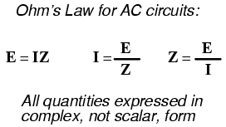
Ohm’s law
Now ohm’s law becomes

Slide 29
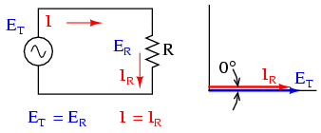
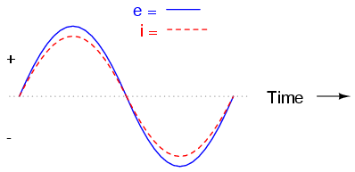
AC Resistor Circuits
Pure resistive AC circuit: resistor voltage and current are in phase.
The wave will look like this

Slide 30
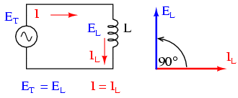

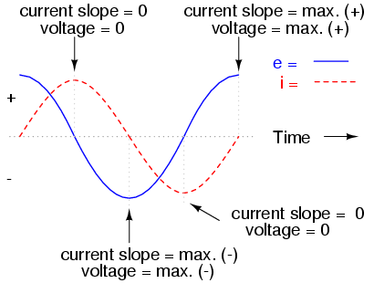
AC inductor Circuits
Pure inductive circuit: Inductor current lags inductor voltage by 90º
^{and}
The wave will look like this

Slide 31
The opposition to alternating current is similar to resistance
The reactance associated with an inductor is usually symbolized by the capital letter X with a letter L as a subscript, X_{L}.
Since inductors drop voltage in proportion to the rate of current change, they will drop more voltage for faster-changing currents, and less voltage for slower-changing currents.
Inductor reactance is directly proportional to the frequency of the alternating current.
Where ω=2∏ƒ
Thus X_{L} = ωL.

Slide 32

AC capacitor Circuits
Capacitors oppose changes in voltage by drawing or supplying current as they charge or discharge to the new voltage level.
The flow of electrons “through” a capacitor is directly proportional to the rate of change of voltage across the capacitor.
This opposition to voltage change is another form of reactance.
the relationship between the current “through” the capacitor and rate of voltage change across the capacitor is

Slide 33
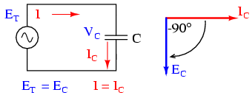
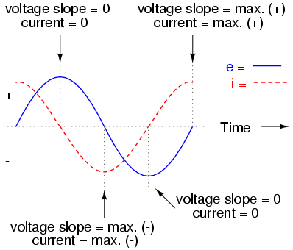
Pure capacitive circuit: capacitor voltage lags capacitor current by -90º
The wave will look like this

Slide 34

The capacitor reactance in ohms for any capacitor is inversely proportional to the frequency of the alternating current.
Capacitive reactance (in ohms) decreases with increasing AC frequency and vice verca.
It can be expressed as
Where ω=2∏ƒ
Thus X_{c} = 1/ωc.

Slide 35
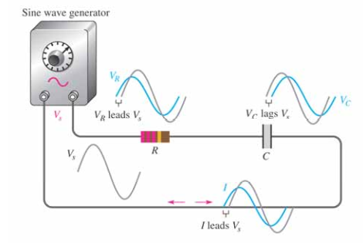
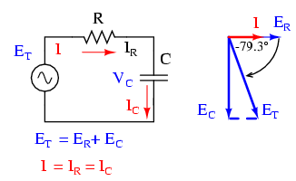
Sinusoidal Response R-C Linear Circuits
A resistor–capacitor circuit (RC circuit) is an electric circuit composed of resistors and capacitors driven by a voltage or current source.
Note: Series capacitor circuit, capacitor voltage lags current by 0º to 90º.

Slide 36
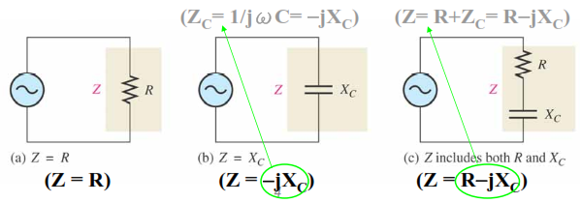
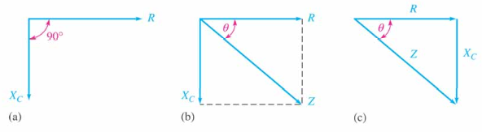
Impedance and Phase Angle of Series RC Circuits
The phase angle is the phase difference between the total current and the source voltage.
The Impedance of a series RC circuit is determined by both the resistance (R) and the capacitive reactance (X_{C}).

Slide 37

Thus the impedance magnitude and the phase angle can be calculated as below.

Slide 38
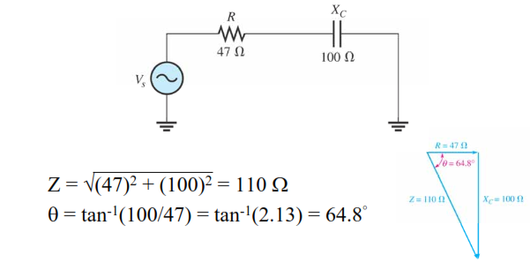
Example 1
Determine the impedance and the phase angle for the circuit below

Slide 39
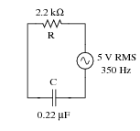
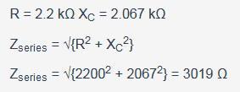
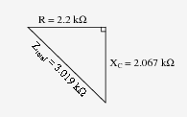
Example 2
Draw a phasor diagram showing the trigonometric relationship between resistance, reactance, and impedance in this series circuit:

Slide 40
Analysis of Series RC Circuits
The application of Ohm’s law to series RC circuits involves the use of the quantities Z, V, and I as:
V=IZ
I=V/Z
Z=V/I
This is essential for circuit analysis in AC circuits

Slide 41
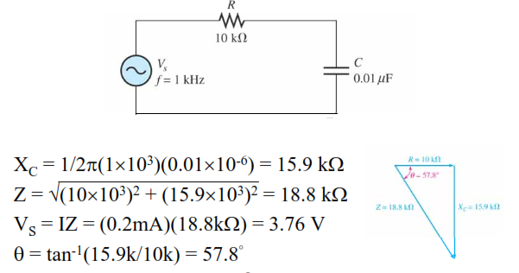
Example: 1.
if the current is 0.2 mA, determine the source voltage and the phase angle.
Note: In a series circuit, the current is the same through both the resistor and the capacitor and the resistor voltage is in phase with the current, and the capacitor voltage lags the current by 90º.

Slide 42
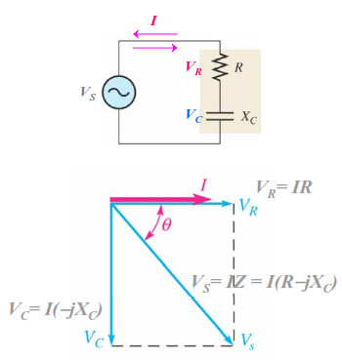
KVL in series RC circuits
From KVL, the sum of the voltage drops must equal the applied voltage (Vs)
Since V_{R} and V_{C} are 90º out of phase with each other, they must be added as phasor quantities. As shown in the figure below.

Slide 43

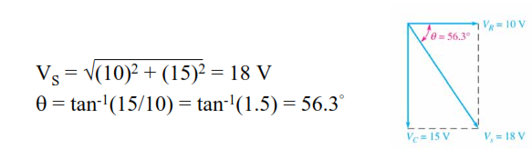
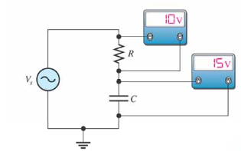
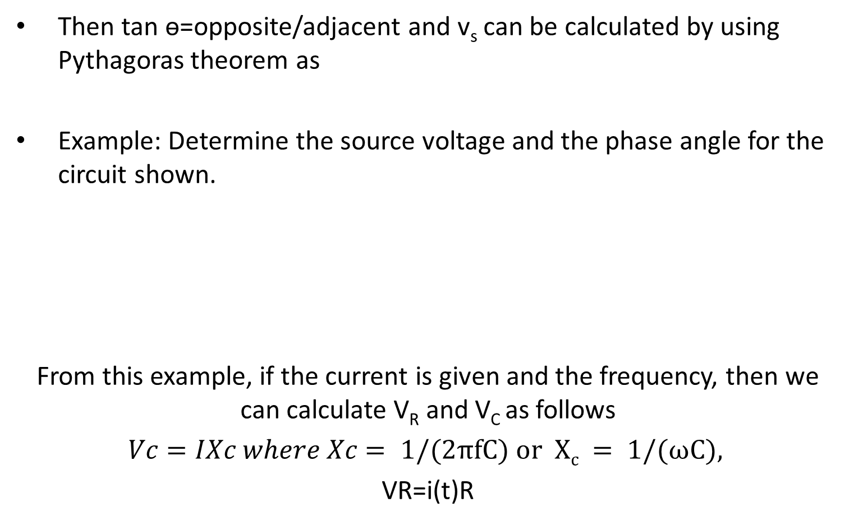
Then tan ө=opposite/adjacent and v_{s} can be calculated by using Pythagoras theorem as
Example: Determine the source voltage and the phase angle for the circuit shown.
From this example, if the current is given and the frequency, then we can calculate V_{R} and V_{C} as follows
$Vc=IXc where Xc= 1/(2πfC) or Xc = 1/(ωC),$
VR=i(t)R

Slide 44
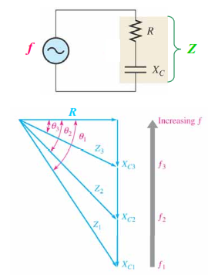
Variation of Impedance and Phase Angle with Frequency
For a series RC circuit, as frequency increases:
R remains constant
XC decreases
Z decreases
Q decreases

Slide 45
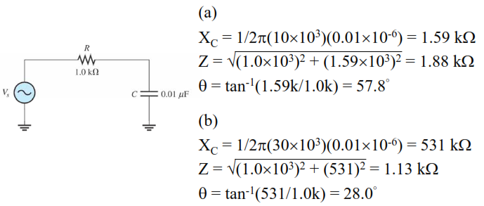
Example
Determine the impedance and phase angle for each of the following values of frequency: (a) 10 kHz (b) 30 kHz

Slide 46
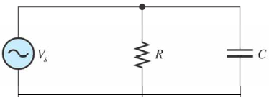
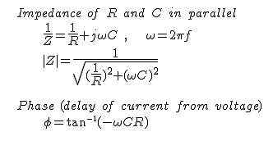

Parallel RC Circuits: Impedance and Phase Angle of Parallel RC Circuits
For the circuit shown, the total impedance can be calculated as
where Xc= 1/ωc, so ωc=1/Xc substituting in the value of ө we obtain the Phase angle between the applied V and the total I as

Slide 47
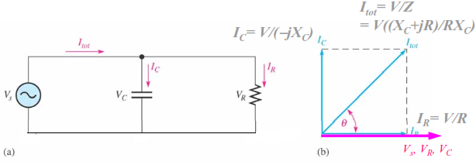
Relationships of the I and V in a Parallel RC Circuit
In Parallel RC Circuit, the applied voltage, Vs appears across both the resistive and the capacitive branches.
Total current, I_{tot} divides at the junction into the two branch current, i_{r} and i_{c}. This is summarized in the figure below.

Slide 48
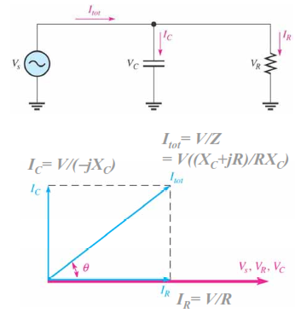

KCL in parallel RC circuits
From KCL, Total current (I_{S}) is the phasor sum of the two branch currents
Since I_{R} and I_{C} are 90o out of phase with each other, they must be added as phasor quantities. Ie
Then the total current shall be;

Slide 49
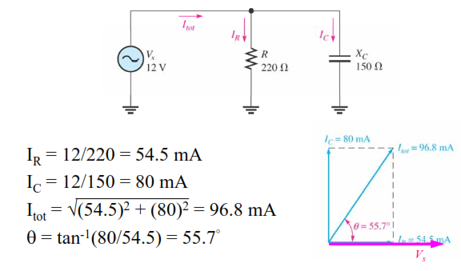
Example:
Determine the value of each current, and describe the phase relationship of each with the source voltage.

Slide 50
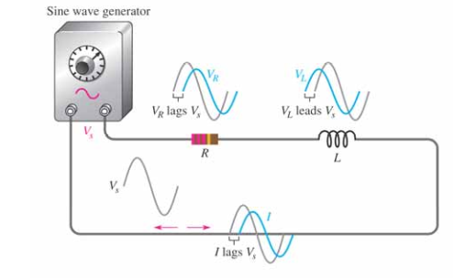
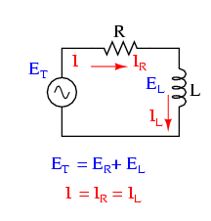
Sinusoidal Response R-L Linear Circuits
  series R-L circuits

Slide 51
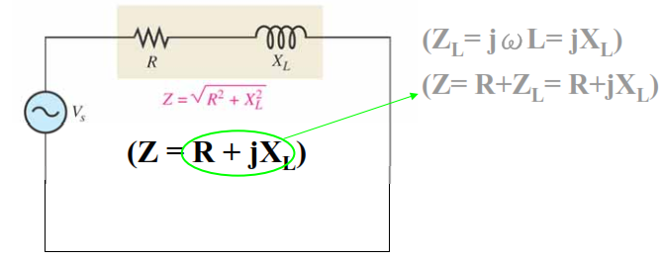
Impedance and Phase Angle of Series RL Circuits
The phase angle is the phase difference between the total current and the source voltage
impedance of a series RL circuit is determined by the resistance (R) and the inductive reactance (X_{L}) as shown in the figure below.

Slide 52

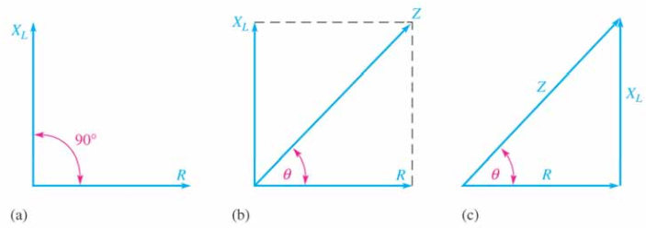
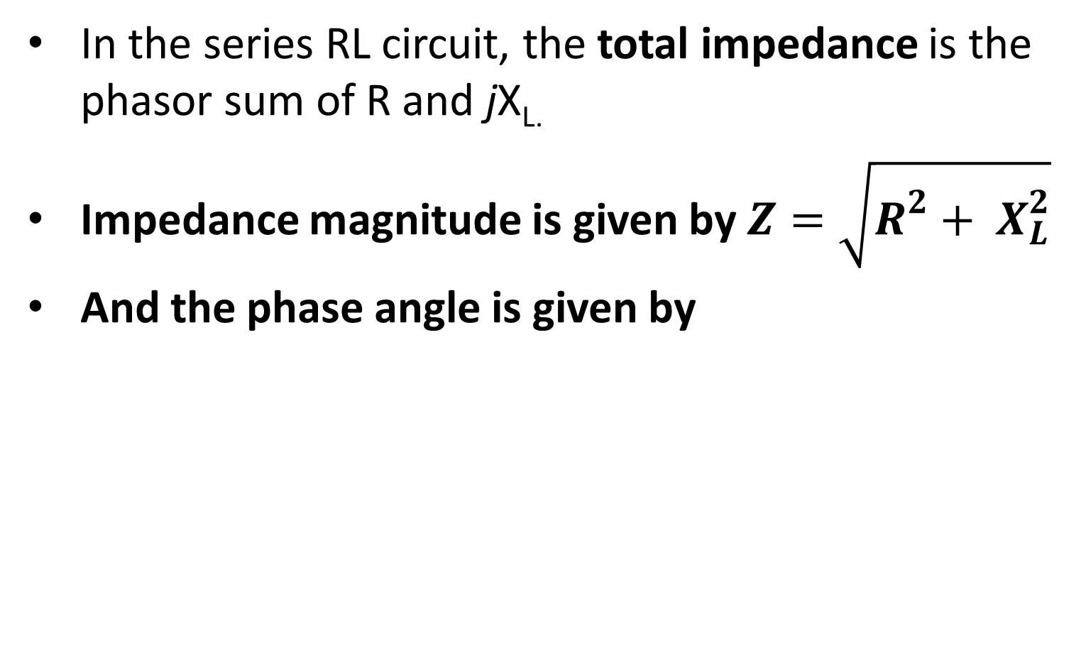
In the series RL circuit, the total impedance is the phasor sum of R and jX_{L.}
Impedance magnitude is given by $Z=\sqrt{R^{2}+ X_{L}^{2}}$
And the phase angle is given by

Slide 53

Example:
Determine the impedance and the phase angle for the circuit shown in the figure below.

Slide 54
Analysis of Series RL Circuits.
Application of Ohm’s Law to series RL circuits involves the use of the quantities Z, V, and I as it was done in R-C circuits.
V=IZ,
I=V/Z and
Z=V/I

Slide 55

Example:
If the current is 0.2 mA, determine the source voltage and the phase angle for the circuit shown.

Slide 56

Relationships of I and V in a Series RL Circuit
In a series circuit, the current is the same through both the resistor and the inductor
The resistor voltage is in phase with the current, and the inductor voltage leads the current by 90º.

Slide 57


KVL in a Series RL Circuit
From KVL, the sum of the voltage drops must equal the source voltage (Vs).
Since V_{R} and V_{L} are 90º out of phase with each other, they must be added as phasor quantities.
Hence the value of Vs can be obtained as phasor addition of V_{R} and V_{L} as

Slide 58

Example
Determine the source voltage and the phase angle for the circuit shown.

Slide 59

Variation of Impedance and Phase Angle with Frequency
For a series RL circuit; as frequency increases:
– R remains constant
–X increases
– Z increases
-ө increases

Slide 60


Parallel RL Circuits
The total impedance in parallel RL circuit is given by
And the phase angle between the applied V and the total I is,
as shown in the figure below

Slide 61


From the circuit shown above,

Slide 62

Relationships of the I and V
In Parallel RL Circuits, the applied voltage Vs, appears across both the resistive and the inductive branches
The total current I, divides at the junction into the two branch current, I_{R} and I_{L}.

Slide 63


KCL in a Parallel RL Circuit
From KCL, Total current is the phasor sum of the two branch currents
Since I_{R} and I_{L} are 90º out of phase with each other, they must be added as phasor quantities.
Then we obtain I tot by using this equation

Slide 64


Example
Determine the value of each current, and describe the phase relationship of each with the source voltage in the circuit shown

Slide 65


Sinusoidal Response R-L-C Linear Circuits
Series RLC Circuit
For the series RLC circuit above, this can be shown as:

Slide 66

The vector diagrams will therefore have the current vector as their reference with the three voltage vectors being plotted with respect to this reference as shown below.

Slide 67


Kirchoff’s voltage law ( KVL ) we get
Phasor Diagram for a Series RLC Circuit will be

Slide 68


Voltage Triangle for a Series RLC Circuit
By substituting these values into Pythagoras’s equation above for the voltage triangle will give us:

Slide 69



The Impedance of a Series RLC Circuit
Consider the triangle below
From the triangle above

Slide 70

Example
A series RLC circuit containing a resistance of 12Ω, an inductance of 0.15H and a capacitor of 100uF are connected in series across a 100V, 50Hz supply. Calculate the total circuit impedance, the circuits current, and draw the voltage phasor diagram.

Slide 71



soluton
Inductive Reactance, X_{L}.
Capacitive Reactance, X_{C}.
Circuit Impedance, Z.
Circuits Current, I.

Slide 72



Voltages across the Series RLC Circuit, V_{R}, V_{L}, V_{C}
Phase Angle, θ.
Phasor Diagram.

Slide 73
Parallel RLC Circuit
Like the series RLC circuit, we can solve this circuit using the phasor or vector method
This time the vector diagram will have the voltage as its reference with the three current vectors plotted with respect to the voltage.
The phasor diagram for a parallel RLC circuit is produced by combining together the three individual phasors for each component and adding the currents vectorially.

Slide 74


Parallel RLC Circuit
Phasor Diagram for a Parallel RLC Circuit

Slide 75


Parallel RLC Circuit
Current Triangle for a Parallel RLC Circuit
Impedance of a Parallel RLC Circuit (by ohm’s low)

Slide 76

Parallel RLC Circuit
Example 1
A 1kΩ resistor, a 142mH coil and a 160uF capacitor are all connected in parallel across a 240V, 60Hz supply. Calculate the impedance of the parallel RLC circuit and the current drawn from the supply.

Slide 77



Parallel RLC Circuit
Solution
Inductive Reactance, ( X_{L} )
Capacitive Reactance, ( X_{C} )
Impedance, ( Z )
Supply Current, ( Is )

Slide 78
Assignment 2
Briefly discuss the following terms and give the practical example on each
1. Admittance of a Parallel RLC Circuit
2. Conductance
3. Susceptance

Slide 79

Quiz/5
Determine the capacitor reactive and the current through the capacitor in the following circuit.

Slide 80


